Slide 1


Find an AI Opportunity in a Real Company
Presented by Imran Ahmad

Slide 2

Welcome
I’m Imran Ahmad, AI PM aspirant from Cohort 3
Expertise in AI-driven business solutions
Passionate about scaling startups
15+ years in tech innovation and data analytics

Slide 3
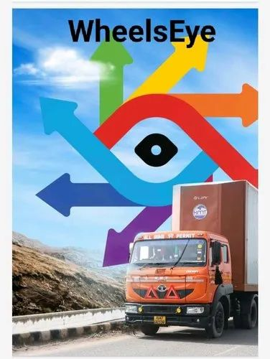
We are focusing on a prominent Indian logistics SaaS and freight marketplace - WheelsEye

Slide 4
1. What does the company do and who pays for it?
What it does
Who pays for it
Digitizes the fragmented Indian trucking ecosystem.
Provides software subscriptions and GPS/telematics hardware to small and medium fleet owners
Manages electronic toll payments (FASTags)
Operates a Full-Truckload (FTL) marketplace connecting commercial enterprises, manufacturers and traders with verified truck operators.
Fleet Owners & Transporters – they pay for software subscriptions, bundled GPS/IoT hardware and any other VAS
Shippers (Enterprises, SMEs, and traders) – they pay freight commissions and service margins to book / move goods across India.

Slide 5

2. How does it make money?
SaaS & Software Subscriptions
Hardware & Bundled Solutions
Marketplace Commissions & FASTag Services

Slide 6
3. What are the main things it has to get right to run well?
Device Reliability & Data Uptime
Carrier Trust & Supply Liquidity
FASTag & Financial Reconciliation

Slide 7
4. Where do things go wrong, or get slow, expensive, or frustrating?
Field Support & Hardware Maintenance Friction:
Informal Credit & Cash Flow Chasing
Fragmented Demand-Supply Matching

Slide 8
5. What information or data does the business collect along the way?
Telemetry & Geospatial Data
Financial & Transactional Logs
Operational & Compliance Records

Slide 9
Quote
Suggestions: AI features

Slide 10
5. What information or data does the business collect along the way?
Feature-1 | Problem it solves | Type of AI | Data needed | What it improves | Metrics it will impact
Vernacular WhatsApp Dispatch & Negotiation Agent | Freight brokers spend excessive time in negotiating rates manually Drivers in Tier2/3 are not tech-proficient or with English as a mode of business language Different states have different languages; may cause communication gap between parties | Generative AI (LLMs, Multimodal Speech-to-Text, Text-to-Speech & Speech-to-Speech) | Historical lane pricing data, live shipper load boards, past WhatsApp chat transcripts, and regional dialect voice datasets. | Speed and scale of load matching, driver engagement friction and the manual workload of human dispatchers. Bridge communication gap between parties; instilling higher trust in transactions. | Lower time to book a load Lower cost-per-load-booked Driver retention/engagement rates.

Slide 11
5. What information or data does the business collect along the way?
Feature-2 | Problem it solves | Type of AI | Data needed | What it improves | Metrics it will impact
Automated Proof-of-Delivery (POD) & Damage Vision Inspector | Getting paid by shippers requires collecting/submitting signed physical documents. Drivers often delay sending paper slips Manual invoice reconciliation is slow and prone to human error. Paper slips may get damaged or lost | Image AI (Computer Vision, Optical Character Recognition (OCR) and Object Detection) | High-volume image datasets of signed paper receipts / challans, delivery receipts Cargo damage reference images Manifest shipment records | Cash flow velocity, invoice accuracy Dispute resolution speed for damaged goods Administrative overhead. | invoice processing cycle time Manual data-entry error rates. Higher successful and secure shipments delivered

Slide 12
5. What information or data does the business collect along the way?
Feature-3 | Problem it solves | Type of AI | Data needed | What it improves | Metrics it will impact
Driver Safety & Drowsiness Audio Telemetry Monitor | Driver fatigue and fatigue-induced accidents on highway routes Safety risks to drivers, cargo loss liabilities and insurance overhead. | Voice AI and Vision AI | In-cabin audio streams, driver audio behavioral baselines, harsh braking/acceleration telemetry events, and historical accident logs. Video feeds of drowsy driving | Driver alertness Proactive safety interventions Overall fleet safety compliance. | Lower accident frequency rate Higher insurance claim payouts (if any) Higher safety incident reports.

Slide 13
5. What information or data does the business collect along the way?
Feature-4 | Problem it solves | Type of AI | Data needed | What it improves | Metrics it will impact
Working Capital Recommender | fleet operators regularly face short-term liquidity crunches for fuel and tolls. | Recommendation AI (Collaborative Filtering, Predictive Models & Predictive Credit Scoring) | Real-time FASTag toll transaction logs, historical route destination data, trip completion histories, fuel purchase records and cash flow patterns. | Timely and predictable working capital access for small operators. | Higher number of Fintech lending Shorter cashflow or working capital cycle

Slide 14

Thank you for your time…

